Slide 1


Principles of Information Security,
Fourth Edition
Chapter 12
Information Security Maintenance

Slide 2
Learning Objectives
Upon completion of this material, you should be able to:
  Discuss the need for ongoing maintenance of the information security program
  List the recommended security management models
  Define a model for a full maintenance program
  Identify the key factors involved in monitoring the external and internal environment
Principles of Information Security, Fourth Edition
Notes:
Upon completion of this material you should be able to:
Discuss the need for the ongoing maintenance of the information security program
List the recommended security management models
Define a model for a full maintenance program
Identify the key factors involved in monitoring the external and internal environment
Describe how planning, risk assessment, vulnerability assessment, and remediation tie into information security maintenance
Explain how to build readiness and review procedures into information security maintenance
Define digital forensics, and describe the management of the digital forensics function
Describe the process of acquiring, analyzing, and maintaining potential evidentiary material

Slide 3
Learning Objectives (cont’d.)
  Describe how planning, risk assessment, vulnerability assessment, and remediation tie into information security maintenance
  Explain how to build readiness and review procedures into information security maintenance
  Define digital forensics, and describe the management of the digital forensics function
  Describe the process of acquiring, analyzing, and maintaining potential evidentiary material
Principles of Information Security, Fourth Edition

Slide 4
Introduction
Organizations should avoid overconfidence after improving their information security profile
Organizational changes that may occur include:
  Acquisition of new assets; emergence of new vulnerabilities; business priorities shift; partnerships form or dissolve; organizational divestiture and acquisition; employee hire and turnover
If program does not adjust, may be necessary to begin cycle again
More expensive to reengineer information security profile again and again
Principles of Information Security, Fourth Edition
Notes:
Introduction
Upon the successful implementation and testing of a new and improved security profile, an organization might feel more confident of the level of protection it is providing for its information assets.
It shouldn’t.
By the time the organization has completed implementing the changes mandated by an upgraded security program, a good deal of time has passed.
In that time, everything that is dynamic in the organization’s environment has changed.
Some of the factors that are likely to shift in the information security environment are:
New assets are acquired.
New vulnerabilities associated with the new or existing assets emerge.
Business priorities shift.
New partnerships are formed.
Old partnerships dissolve.
Organizational divestiture and acquisition occur.
Employees who are trained, educated, and made aware of the new policies, procedures, and technologies leave.
New personnel are hired possibly creating new vulnerabilities.
If the program is not adjusting adequately to change, it may be necessary to begin the cycle again.
That decision depends on how much change has occurred and how well the organization and its program for information security maintenance can accommodate change.
If an organization deals successfully with change and has created procedures and systems that can flex with the environment, the security program can probably continue to adapt successfully.
The CISO determines whether the information security group can adapt adequately and maintain the information security profile of the organization or whether the macroscopic process of the SecSDLC must start anew to redevelop a fundamentally new information security profile.
It is less expensive and more effective when an information security program is designed and implemented to deal with change.
It is more expensive to reengineer the information security profile again and again.

Slide 5
Security Management Maintenance Models
Management model must be adopted to manage and operate ongoing security program
Models are frameworks that structure tasks of managing particular set of activities or business functions
Principles of Information Security, Fourth Edition
Notes:
Security Management Models
To assist the information security community to manage and operate the ongoing security program, a management model must be adopted.
In general, management models are frameworks that structure the tasks of managing a particular set of activities or business functions.

Slide 6
NIST SP 800-100 Information Security Handbook: A Guide for Managers
Provides managerial guidance for establishing and implementing of an information security program
Thirteen areas of information security management
  Provide for specific monitoring activities for each task
  Tasks should be done on an ongoing basis
  Not all issues are negative
Principles of Information Security, Fourth Edition

Slide 7
NIST SP 800-100 Information Security Handbook: A Guide for Managers (cont’d.)
Information security governance
  Agencies should monitor the status of their programs to ensure that:
    Ongoing information security activities provide support to agency mission
    Current policies and procedures are technology-aligned
    Controls are accomplishing the intended purpose
System development life cycle:
  The overall process of developing, implementing, and retiring information systems through a multistep process
Principles of Information Security, Fourth Edition

Slide 8
NIST SP 800-100 Information Security Handbook: A Guide for Managers (cont’d.)
Awareness and training
  Tracking system should capture key information on program activities
  Tracking compliance involves assessing the status of the program
  The program must continue to evolve
Capital planning and investment control
  Designed to facilitate and control the expenditure of agency funds
  Select-control-evaluate investment life cycle
Principles of Information Security, Fourth Edition

Slide 9
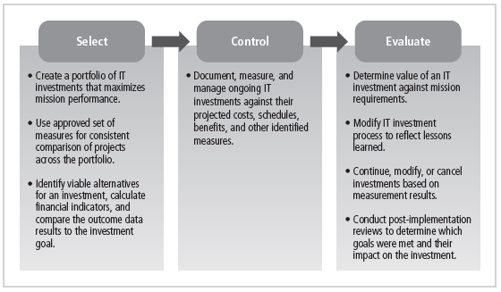
Figure 12-1 Select-Control-Evaluate Investment Life Cycle
Principles of Information Security, Fourth Edition

Slide 10
NIST SP 800-100 Information Security Handbook: A Guide for Managers (cont’d.)
Interconnecting systems
  The direct connection of two or more information systems for sharing data and other information resources
  Can expose the participating organizations to risk
  When properly managed, the added benefits include greater efficiency, centralized access to data, and greater functionality
Performance measures
  Metrics: tools that support decision making
  Six phase iterative process
Principles of Information Security, Fourth Edition

Slide 11
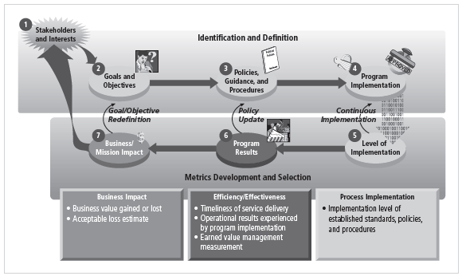
Figure 12-3 Information Security Metrics Development Process
Principles of Information Security, Fourth Edition

Slide 12
NIST SP 800-100 Information Security Handbook: A Guide for Managers (cont’d.)
Security planning: one of the most crucial ongoing responsibilities in security management
Information technology contingency planning: consists of a process for recovery and documentation of procedures
Risk management
  Ongoing effort
  Tasks include performing risk identification, analysis, and management
Principles of Information Security, Fourth Edition

Slide 13
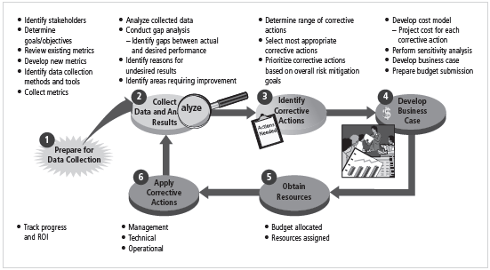
Figure 12-4 Information Security Metrics Program Implementation Process
Principles of Information Security, Fourth Edition

Slide 14
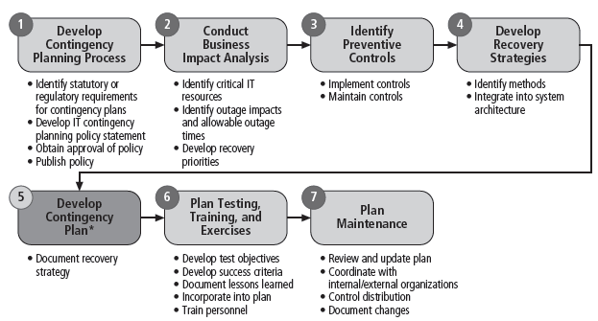
Figure 12-5 The NIST Seven-Step Contingency Planning Process
Principles of Information Security, Fourth Edition

Slide 15
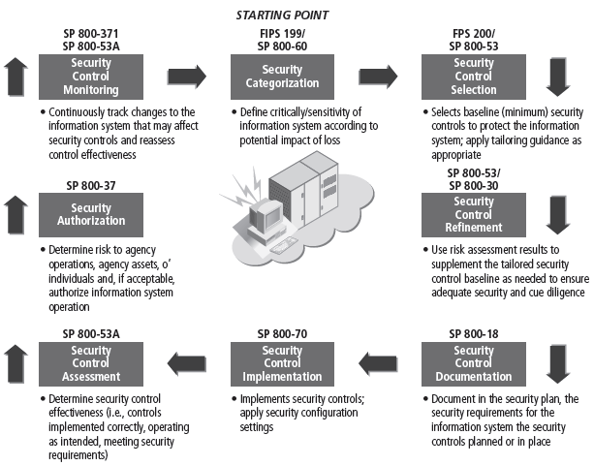
Figure 12-6 Risk Management in the System Security Life Cycle
Principles of Information Security, Fourth Edition

Slide 16
NIST SP 800-100 Information Security Handbook: A Guide for Managers (cont’d.)
Certification, accreditation, and security assessments
  An essential component in any security program
  The status of security controls is checked regularly
  Auditing: the process of reviewing the use of a system for misuse or malfeasance
Security services and products acquisition
Incident response: incident response life cycle
Configuration (or change) management: manages the effects of changes in configurations
Principles of Information Security, Fourth Edition

Slide 17
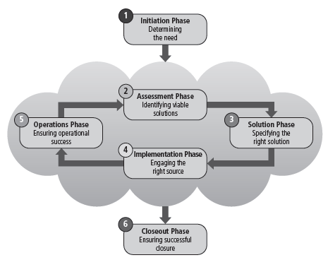
Figure 12-7 The Information Security Services Life Cycle
Principles of Information Security, Fourth Edition

Slide 18
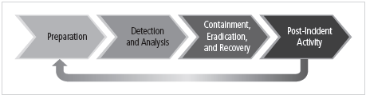
Figure 12-8 The Incident Response Life Cycle
Principles of Information Security, Fourth Edition

Slide 19
The Security Maintenance Model
Designed to focus organizational effort on maintaining systems
Recommended maintenance model based on five
subject areas:
  External monitoring
  Internal monitoring
  Planning and risk assessment
  Vulnerability assessment and remediation
  Readiness and review
Principles of Information Security, Fourth Edition
Notes:
The Maintenance Model
A maintenance model is intended to complement the chosen management model and focus organizational effort on maintenance.
This figure diagrams a full maintenance program and forms a framework for the discussion of maintenance that follows.
External monitoring
Internal monitoring
Planning and risk assessment
Vulnerability assessment and remediation
Readiness and review

Slide 20
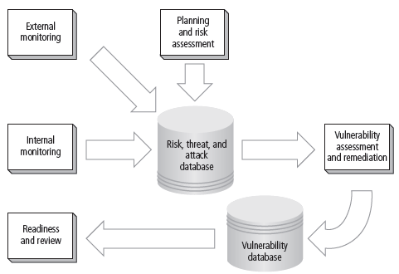
Figure 12-10 The Maintenance Model
Principles of Information Security, Fourth Edition

Slide 21
Monitoring the External Environment
Objective to provide early awareness of new threats, threat agents, vulnerabilities, and attacks that is needed to mount an effective defense
Entails collecting intelligence from data sources and giving that intelligence context and meaning for use by organizational decision makers
Principles of Information Security, Fourth Edition
Notes:
Monitoring the External Environment
The objective of the external monitoring domain within the maintenance model is to provide the early awareness of new and emerging threats, threat agents, vulnerabilities, and attacks that is needed to mount an effective and timely defense.
External monitoring entails collecting intelligence from data sources and then giving that intelligence context and meaning for use by decision makers within the organization.

Slide 22
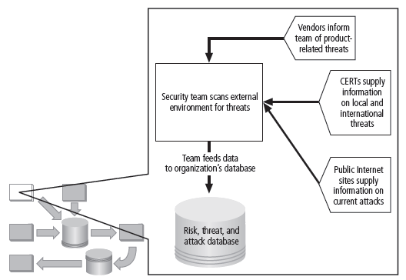
Figure 12-11 External Monitoring
Principles of Information Security, Fourth Edition

Slide 23
Monitoring the External Environment (cont’d.)
Data sources
  Acquiring threat and vulnerability data is not difficult
  Turning data into information decision makers can use is the challenge
  External intelligence comes from three classes of sources: vendors, computer emergency response teams (CERTs), public network sources
  Regardless of where or how external monitoring data is collected, must be analyzed in context of organization’s security environment to be useful
Principles of Information Security, Fourth Edition
Notes:
Data Sources
Acquiring data about threats, threat agent, vulnerabilities, and attacks is not difficult.
There are many sources and few costs associated with gathering the raw intelligence.
What is challenging and can be expensive is turning this flood of good and timely data into information that decision makers can use.
External intelligence can come from three classes of sources:
Vendors
CERT organizations
Public network sources
Regardless of how the organization collects external monitoring data, the CISO evaluates the actions and personnel needed to act on the information.
The responsibility for establishing a viable external monitoring program extends to:
Creating documented and repeatable procedures
Providing proper training to primary and backup staff assigned to perform the monitoring tasks
Equipping assigned staff with proper access and tools to perform the monitoring function
Designing criteria and cultivating expertise among the monitoring analysts, so that they can perform analytic steps to cull meaningful summaries and actionable alerts from the vast flow of raw intelligence
Developing suitable communications methods for moving weighted external intelligence to designated internal decision makers in all three communities
Integrating the incident response plan with the results of the external monitoring process for appropriate, timely responses

Slide 24
Monitoring the External Environment (cont’d.)
Monitoring, escalation, and incident response
  Function of external monitoring process is to monitor activity, report results, and escalate warnings
  Monitoring process has three primary deliverables:
    Specific warning bulletins issued when developing threats and specific attacks pose measurable risk to organization
    Periodic summaries of external information
    Detailed intelligence on highest risk warnings
Principles of Information Security, Fourth Edition
Notes:
Monitoring, Escalation, and Incident Response
The basic function of the external monitoring process is to monitor activity, report results, and escalate warnings.
The optimum approach for escalation is to rely on a thorough integration into the planning and process steps of the IRP .
The monitoring process has three primary deliverables:
Specific warning bulletins issued when developing threats and specific attacks pose a measurable risk to the organization
Periodic summaries of external information
Detailed intelligence on the highest risk warnings

Slide 25
Monitoring the External Environment (cont’d.)
Data collection and management
  Over time, external monitoring processes should capture knowledge about external environment in appropriate formats
  External monitoring collects raw intelligence, filters for relevance, assigns a relative risk impact, and communicates to decision makers in time to make a difference
Principles of Information Security, Fourth Edition
Notes:
Data Collection and Management
Over time, the external monitoring processes should capture knowledge about the external environment in a format that can be referenced both across the organization as threats emerge and for historical use.
In the final analysis, external monitoring collects raw intelligence, filters it for relevance to the organizations, assigns it a relative risk impact, and communicates these findings to the decision makers in time to make a difference.

Slide 26
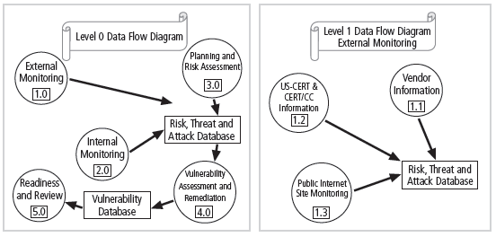
Figure 12-12 Data Flow Diagrams for External Data Collection
Principles of Information Security, Fourth Edition

Slide 27
Monitoring the Internal Environment
Maintain informed awareness of state of organization’s networks, systems, and security defenses
Internal monitoring accomplished by:
  Doing inventory of network devices and channels, IT infrastructure and applications, and information security infrastructure elements
  Leading the IT governance process
  Real-time monitoring of IT activity
  Monitoring the internal state of the organization’s networks and systems
Principles of Information Security, Fourth Edition
Notes:
Monitoring the Internal Environment
It is just as important to monitor the external environment as the internal environment, that is the internal computing environment.
The primary goal of the internal monitoring domain is to maintain an informed awareness of the state of all of the organization’s networks, information systems, and information security defenses.
Internal monitoring is accomplished by:
Building and maintaining an inventory of network devices and channels, IT infrastructure and applications, and information security infrastructure elements
Active participation in, or leadership of, the IT governance process within the organization to integrate the inevitable changes found in all network, IT, and information security programs
Real-time monitoring of IT activity using intrusion detection systems to detect and initiate responses to specific actions or trends of events that introduce risk to the organization’s assets
Periodic monitoring of the internal state of the organization’s networks and systems
This recursive review of the network and system devices that are inline at any given moment and any changes to the services offered on the network is needed to maintain awareness of new and emerging threats.
This can be accomplished through automated difference detection methods that identify variances introduced to the network or system hardware and software.

Slide 28
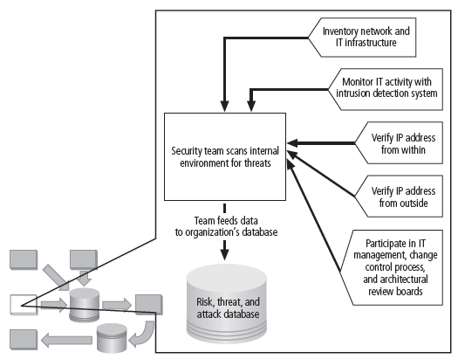
Figure 12-13 Internal Monitoring
Principles of Information Security, Fourth Edition

Slide 29
Monitoring the Internal Environment (cont’d.)
Network characterization and inventory
  Organizations should have carefully planned and fully populated inventory for network devices, communication channels, and computing devices
  Once characteristics identified, they must be carefully organized and stored using a mechanism (manual or automated) that allows timely retrieval and rapid integration of disparate facts
Principles of Information Security, Fourth Edition
Notes:
Network Characterization and Inventory
Each organization should have a carefully planned and fully populated inventory for all network devices, communication channels, and computing devices.
The process of collecting this information can be called characterization, which is the systematic collection of the characteristics of the network and computer devices present in the environment.
Once the characteristics have been identified, they must be carefully organized and stored using a mechanism, manual or automated, that allows timely retrieval and rapid integration of disparate facts.

Slide 30
Monitoring the Internal Environment (cont’d.)
Making intrusion detection and prevention systems work
  The most important value of raw intelligence provided by the IDS is providing indicators of current or imminent vulnerabilities
  Log files from IDS engines can be mined for information
  Another IDS monitoring element is traffic analysis
  Analyzing attack signatures for unsuccessful system attacks can identify weaknesses in various security efforts
Principles of Information Security, Fourth Edition
Notes:
Making Intrusion Detection Systems Work
To be effective, IDS must be integrated into the maintenance process.
An endless flow of alert messages makes little difference to the effectiveness of the information security program.
After all, the IDS is reporting events that have already occurred.
The most important value of the raw intelligence provided by the IDS is to prevent risk in the future.
Whether the organization has outsourced IDS monitoring, staffs IDS monitoring 24 x 7, staffs IDS monitoring 8 x 5, or merely ignores the real-time alerts from IDS, the log files from the IDS engines can be mined to add information to the internal monitoring knowledge base.
Analyzing attack signatures for unsuccessful system attacks can identify weaknesses in various security efforts.
One approach that has achieved good results is to perform combinations of manual and automated difference analysis to identify changes to the internal environment.

Slide 31
Monitoring the Internal Environment (cont’d.)
Detecting differences
  Difference analysis: procedure that compares current state of network segment against known previous state of same segment
  Differences between the current state and the baseline state that are unexpected could be a sign of trouble and need investigation
Principles of Information Security, Fourth Edition
Notes:
Detecting Differences
A difference analysis is a procedure that compares the current state of a network segment against a known previous state of that same network segment.
Any differences between the current state and the baseline state that are unexpected could be a sign of trouble and will need to be investigated.

Slide 32
Planning and Risk Assessment
Primary objective is to keep lookout over entire information security program
Accomplished by identifying and planning ongoing information security activities that further reduce risk
Principles of Information Security, Fourth Edition
Notes:
Planning and Risk Assessment
The primary objective of the planning and risk assessment domain is to keep an eye on the entire information security program.
This is done in part by identifying and planning ongoing information security activities that further reduce risk.
Also, the risk assessment group identifies and documents risks introduced by both IT projects and information security projects.
Further, it identifies and documents risks that may be latent in the present environment.
The primary outcomes from this domain are:
Establishing a formal information security program review process that complements and supports both the IT planning process and strategic planning processes
Instituting formal project identification, selection, planning, and management processes for information security follow-on activities that augment the current program
Coordinating with IT project teams to introduce risk assessment and review for all IT projects, so that risks introduced from the introduction of IT projects are identified, documented, and factored into projects decisions
Integrating a mindset of risk assessment across the organization to encourage the performance of risk assessment activities when any technology system is implemented or modified

Slide 33
Planning and Risk Assessment (cont’d.)
Primary objectives
  Establishing a formal information security program review
  Instituting formal project identification, selection, planning, and management processes
  Coordinating with IT project teams to introduce risk assessment and review for all IT projects
  Integrating a mindset of risk assessment across organization
Principles of Information Security, Fourth Edition

Slide 34
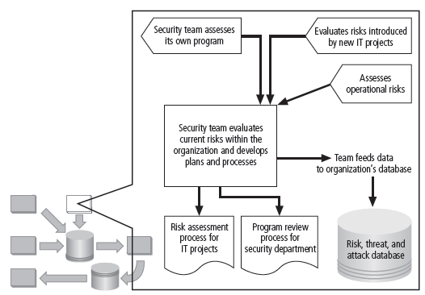
Figure 12-14 Planning and Risk Assessment
Principles of Information Security, Fourth Edition

Slide 35
Planning and Risk Assessment (cont’d.)
Information security program planning
and review
  Periodic review of ongoing information security program coupled with planning for enhancements and extensions is recommended
  Should examine IT needs of future organization and impact those needs have on information security
  A recommended approach takes advantage of the fact most organizations have annual capital budget planning cycles and manage security projects as part of that process
Principles of Information Security, Fourth Edition
Notes:
Information Security Program Planning and Review
Periodic review of an ongoing information security program coupled with planning for enhancements and extensions is a recommended practice for each organization.
The strategic planning process should examine the IT needs of the future organization and the impact those needs have on information security.
A recommended approach takes advantage of the fact that most organizations have annual capital budget planning cycles and manage security projects as part of that process.

Slide 36
Planning and Risk Assessment (cont’d.)
Large projects should be broken into smaller projects for several reasons
  Smaller projects tend to have more manageable impacts on networks and users
  Larger projects tend to complicate change control process in implementation phase
  Shorter planning, development, and implementation schedules reduce uncertainty
  Most large projects can easily be broken down into smaller projects, giving more opportunities to change direction and gain flexibility
Principles of Information Security, Fourth Edition
Notes:
InfoSec Improvement through Ongoing Projects
The projects follow the SecSDLC model for development and implementation, if the organization does not have a SDLC methodology that would supercede its use.
After the program is in place, large projects should be broken into smaller projects for several reasons:
Smaller projects tend to have more manageable impacts to the networks and users.
Larger projects tend to complicate the change control process in the implementation phase.
Short planning, development, and implementation schedules reduce uncertainty for IT planners and financial sponsors.
Most large projects can easily be assembled from smaller projects, giving more opportunities to change direction and gain flexibility as events occur and circumstances change.

Slide 37
Planning and Risk Assessment (cont’d.)
Security risk assessments
  A key component for driving security program change is information security operational risk assessment (RA)
  RA identifies and documents risk that project, process, or action introduces to organization and offers suggestions for controls
  Information security group coordinates preparation of many types of RA documents
Principles of Information Security, Fourth Edition
Notes:
Security Risk Assessments
A key component in the engine that drives change in the information security program is a relatively straightforward process called an information security operational risk assessment.
The RA is a method to identify and document the risk that a project, process, or action introduces to the organization and, perhaps offer suggestions for controls that can reduce that risk.
The information security group often finds itself in the business of coordinating the preparation of many different types of RA documents including:
Network connectivity
Dialed modem
Business partner
Application
Vulnerability
Privacy
Acquisition or divesture
Other RAs

Slide 38
Vulnerability Assessment and Remediation
Primary goal: identification of specific, documented vulnerabilities and their timely remediation
Accomplished by:
  Using vulnerability assessment procedures
  Documenting background information and providing tested remediation procedures for vulnerabilities
  Tracking vulnerabilities from when they are identified
  Communicating vulnerability information to owners of vulnerable systems
  Reporting on the status of vulnerabilities
  Ensuring the proper level of management is involved
Principles of Information Security, Fourth Edition
Notes:
Vulnerability Assessment and Remediation
The primary goal of the vulnerability assessment and remediation domain is the identification of specific, documented vulnerabilities and their timely remediation.
This is accomplished by:
Using vulnerability assessment procedures that are documented to safely collect intelligence about network, platforms, dial-in modems, and wireless network systems
Documenting background information and providing tested remediation procedures for the reported vulnerabilities
Tracking, communicating, reporting, and escalating to management the itemized facts about the discovered vulnerabilities and the success or failure of the organization to remediate them

Slide 39
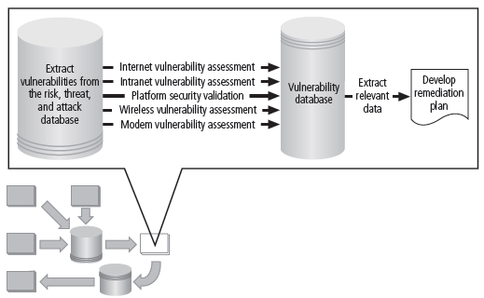
Figure 12-15 Vulnerability Assessment and Remediation
Principles of Information Security, Fourth Edition

Slide 40
Vulnerability Assessment and Remediation (cont’d.)
Process of identifying and documenting specific and provable flaws in organization’s information asset environment
Five vulnerability assessment processes that follow can serve many organizations as they attempt to balance intrusiveness of vulnerability assessment with need for stable and productive production environment
Principles of Information Security, Fourth Edition
Notes:
Vulnerability Assessment
The process of identifying and documenting specific and provable flaws in the organization’s information asset environment is called vulnerability assessment.
While the exact procedures can vary, the following five vulnerability assessment processes can serve many organizations as they attempt to balance the intrusiveness of vulnerability assessment with the need for a stable and productive production environment.

Slide 41
Vulnerability Assessment and Remediation (cont’d.)
Penetration testing
  A level beyond vulnerability testing
  Is a set of security tests and evaluations that simulate attacks by a malicious external source (hacker)
  Penetration test (pen test): usually performed periodically as part of a full security audit
  Can be conducted one of two ways: black box or white box
Principles of Information Security, Fourth Edition

Slide 42
Vulnerability Assessment and Remediation (cont’d.)
Internet vulnerability assessment
  Designed to find and document vulnerabilities present in organization’s public-facing network
  Steps in the process include:
    Planning, scheduling, and notification
    Target selection
    Test selection
    Scanning
    Analysis
    Record keeping
Principles of Information Security, Fourth Edition
Notes:
Internet Vulnerability Assessment
The Internet vulnerability assessment process is designed to find and document the vulnerabilities that may be present in the public-facing network of the organization.
Since attackers from this direction take advantage of any loophole or flaw, this assessment is usually performed against all public-facing addresses, using every possible penetration testing approach.
The steps in the process are:
Planning, scheduling, and notification of the penetration testing: Large organizations often take an entire month to perform the data collection phase, using nights and weekends and avoiding change control blackout windows. The various technical support communities are given the detailed plan so that they know when each device is scheduled for testing and what tests are used.
Target selection: Working from the network characterization database elements that are stored in the risk, threat, and attack database, the penetration targets are selected.
Test selection: Using the external monitoring intelligence generated previously, the test engine is configured for the tests to be performed.
Scanning: The penetration test engine is unleashed at the scheduled time using the planned target list and test selection. The results of the entire test run are logged to text log files for analysis. This should be a monitored process so that if an invasive penetration test causes a disruption to a targeted system, the outage can be reported immediately for recovery.
Analysis: A knowledgeable and experienced vulnerability analyst screens the test results for the vulnerabilities logged during scanning.
Record keeping: Record the details of the documented vulnerability in the vulnerability database, identifying the logical and physical characteristics and assigning a response risk level to the vulnerability to differentiate the truly urgent from the merely critical.

Slide 43
Vulnerability Assessment and Remediation (cont’d.)
Intranet vulnerability assessment
  Designed to find and document selected vulnerabilities present on the internal network
  Attackers are often internal members of organization, affiliates of business partners, or automated attack vectors (such as viruses and worms)
  This assessment is usually performed against selected critical internal devices with a known, high value by using selective penetration testing
  Steps in process almost identical to steps in Internet vulnerability assessment
Principles of Information Security, Fourth Edition
Notes:
Intranet Vulnerability Assessment
The intranet vulnerability assessment process is designed to find and document selected vulnerabilities that are likely to be present on the internal network of the organization.
Attackers from this direction are often internal members of the organization, affiliates of business partners, or automated attack vectors (such as viruses and worms).
This assessment is usually performed against selected critical internal devices with a known, high value by using selective penetration testing.
The steps in the process are almost identical to the steps in the Internet vulnerability assessment, except as noted.
Planning, scheduling, and notification of the penetration testing: There will be substantially more systems to assess. Often intranet administrators prefer penetration testing be performed during working hours.
Target selection: At first, the penetration test scanning and analysis should focus on testing only the highest value, most critical systems. As the configuration of these systems is improved, and fewer candidate vulnerabilities are found in the scanning step, the target list can be expanded.
Test selection: The selection of the tests to be performed usually evolves over time to match the evolution of the threat environment. Most organizations focus their intranet scanning efforts on a few, very critical vulnerabilities at first, and then expand the test pool to include more scripts.
Scanning: Just as in Internet scanning, the process should be monitored, so that if an invasive penetration test causes disruption, it can be reported for repair.
Analysis: Follows the same three steps: classify, validate and document.
Record keeping: Identical to the one followed in Internet vulnerability analysis.

Slide 44
Vulnerability Assessment and Remediation (cont’d.)
Platform security validation
  Designed to find and document vulnerabilities that may be present because of misconfigured systems in use within organization
  These misconfigured systems fail to comply with company policy or standards
  Fortunately, automated measurement systems are available to help with the intensive process of validating compliance of platform configuration with policy
Principles of Information Security, Fourth Edition
Notes:
Platform Security Validation
The platform security validation (PSV) process is designed to find and document the vulnerabilities that may be present because of misconfigured systems in use within the organization.
These misconfigured systems fail to comply with company policy or standards as adopted by the IT governance groups and communicated in the information security and awareness program.
Fortunately automated measurement systems are available to help with the intensive process of validating the compliance of platform configuration with policy.

Slide 45
Vulnerability Assessment and Remediation (cont’d.)
Wireless vulnerability assessment
  Designed to find and document vulnerabilities that may be present in wireless local area networks of organization
  Since attackers from this direction are likely to take advantage of any loophole or flaw, assessment is usually performed against all publicly accessible areas using every possible wireless penetration testing approach
Principles of Information Security, Fourth Edition
Notes:
Wireless Vulnerability Assessment
The wireless vulnerability assessment process is designed to find and document the vulnerabilities that may be present in the wireless local area networks of the organization.
Since attackers from this direction are likely to take advantage of any loophole or flaw, this assessment is usually performed against all publicly accessible areas using every possible wireless penetration testing approach.

Slide 46
Vulnerability Assessment and Remediation (cont’d.)
Modem vulnerability assessment
  Designed to find and document any vulnerability present on dial-up modems connected to organization’s networks
  Since attackers from this direction take advantage of any loophole or flaw, assessment is usually performed against all telephone numbers owned by the organization
  One element of this process, often called war dialing, uses scripted dialing attacks against pool of phone numbers
Principles of Information Security, Fourth Edition
Notes:
Modem Vulnerability Assessment
The modem vulnerability assessment process is designed to find and document any vulnerability that is present on dialup modems connected to the organization’s networks.
Since attackers from this direction take advantage of any loophole or flaw, this assessment is usually performed against all telephone numbers owned by the organization, using every possible penetration testing approach.
One of the elements of this process, using scripted dialing attacks against a pool of phone numbers, is often called war dialing.

Slide 47
Vulnerability Assessment and Remediation (cont’d.)
Documenting vulnerabilities
  Vulnerability tracking database should provide details as well as a link to the information assets
  Low-cost and ease of use makes relational databases a realistic choice
  Vulnerability database is an essential part of effective remediation
Principles of Information Security, Fourth Edition
Notes:
Documenting Vulnerabilities
The vulnerability database, like the risk, threat, and attack database, both stores and tracks information.
It should provide details about the vulnerability being reported as well as linkage to the information assets characterized in the risk, threat, and attack database.
While this can be manual data storage, the low cost and ease of use of relational databases makes them a more realistic choice.
The data stored in the vulnerability database should include:
A unique vulnerability ID number for reporting and tracking remediation actions
Linkage to the risk, threat, and attack database based on the physical information asset underlying the vulnerability
Vulnerability details usually based on the test script used for the scanning step of the process
Dates and times of notification and remediation activities
Current status of the vulnerability instance
Comments
Other fields as needed
The vulnerability database is an essential part of effective remediation to avoid losing track of specific vulnerability instances as they are reported and remediated.

Slide 48
Vulnerability Assessment and Remediation (cont’d.)
Remediating vulnerabilities
  Objective is to repair flaw causing a vulnerability instance or remove risk associated with vulnerability
  As last resort, informed decision makers with proper authority can accept risk
  Important to recognize that building relationships with those who control information assets is key to success
  Success depends on organization adopting team approach to remediation, in place of cross-organizational push and pull
Principles of Information Security, Fourth Edition
Notes:
Remediating Vulnerabilities
The objective of remediation is to repair the flaw causing a vulnerability instance or remove the risk from the vulnerability.
As a last resort, informed decision makers with the proper authority can accept the risk.
When approaching the remediation process, it is important to recognize that building relationships with those who control the information assets is the key to success.
Success depends on the organization adopting a team approach to remediation, in place of cross-organizational push and pull.

Slide 49
Vulnerability Assessment and Remediation (cont’d.)
Acceptance or transference of risk
  In some instances, risk must simply be acknowledged as part of organization’s business process
  Management must be assured that decisions made to assume risk the organization are made by properly informed decision makers
  Information security must make sure the right people make risk assumption decisions with complete knowledge of the impact of the decision
Principles of Information Security, Fourth Edition
Notes:
Acceptance of Risk
In some instances risk must simply be acknowledged as part of organization’s business process.
The information security professional must assure the general management community that the decisions made to assume risk for the organization are made by properly informed decision makers.
These decision makers must have the proper level of authority to assume the risk.
In the final analysis, the information security group must make sure the right people make risk assumption decisions with complete knowledge of the impact of the decision balanced against the cost of the possible security controls.

Slide 50
Vulnerability Assessment and Remediation (cont’d.)
Threat removal
  In some circumstances, threats can be removed without repairing vulnerability
  Vulnerability can no longer be exploited, and risk has been removed
  Other vulnerabilities may be amenable to other controls that do not allow an expensive repair and still remove risk from situation
Principles of Information Security, Fourth Edition
Notes:
Threat Removal
In some circumstances, threats can be removed without repairing the vulnerability.
The vulnerability can no longer be exploited, and the risk has been removed.
Other vulnerabilities may be amenable to other controls that allow an inexpensive repair and still remove the risk from the situation.

Slide 51
Vulnerability Assessment and Remediation (cont’d.)
Vulnerability repair
  Optimum solution in most cases is to repair vulnerability
  Applying patch software or implementing a workaround often accomplishes this
  In some cases, simply disabling the service removes vulnerability; in other cases, simple remedies are possible
  Most common repair is application of a software patch
Principles of Information Security, Fourth Edition
Notes:
Vulnerability Repair
The optimum solution in most cases is to repair the vulnerability.
Applying patch software or implementing a workaround to the vulnerability often accomplishes this.
In some cases, simply disabling the service removes the vulnerability. In other cases, simple remedies are possible.
Of course, a common remedy remains the application of a software patch to make the system function in the expected fashion and to remove the vulnerability.

Slide 52
Readiness and Review
Primary goal is to keep information security program functioning as designed and continuously improving
Accomplished by:
  Policy review
  Program review
  Rehearsals
Principles of Information Security, Fourth Edition
Notes:
Readiness and Review
The primary goal of the readiness and review domain is to keep the information security program functioning as designed and continuously improving over time.
This is accomplished by:
Policy review: Sound policy needs to be reviewed and refreshed from time to time to provide a current foundation for the information security program.
Readiness review: Major planning components should be reviewed on a periodic basis to ensure they are current, accurate, and appropriate.
Rehearsals: When possible, major plan elements should be rehearsed.
Policy review is the primary initiator of the readiness and review domain.
As policy is revised or current policy is confirmed, the various planning elements are reviewed for compliance, the information security program is reviewed, and rehearsals are held to make sure all participants are capable of responding as needed.

Slide 53
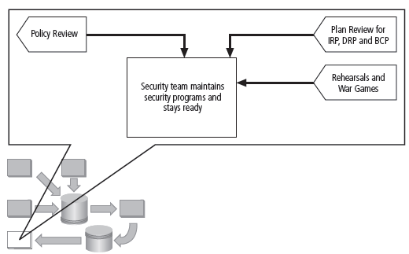
Figure 12-16 Readiness and Review
Principles of Information Security, Fourth Edition

Slide 54
Digital Forensics
Used to investigate what happened during attack on assets and how attack occurred
Based on the field of traditional forensics
Involves preservation, identification, extraction, documentation, and interpretation of computer media for evidentiary and/or root cause analysis
Evidentiary material (EM): any information that could potentially support organizations legal or policy-based case against suspect
Principles of Information Security, Fourth Edition

Slide 55
Digital Forensics (cont’d.)
Used for two key purposes:
  To investigate allegations of digital malfeasance
  To perform root cause analysis
Organization chooses one of two approaches:
  Protect and forget (patch and proceed): defense of data and systems that house, use, and transmit it
  Apprehend and prosecute (pursue and prosecute): identification and apprehension of responsible individuals, with additional attention on collection and preservation of potential EM that might support administrative or criminal prosecution
Principles of Information Security, Fourth Edition

Slide 56
The Digital Forensics Team
Most organizations
  Cannot sustain a permanent digital forensics team
  Collect data and outsource analysis
Information security group personnel should be trained to understand and manage the forensics process to avoid contamination of potential EM
Expertise can be obtained by training
Principles of Information Security, Fourth Edition

Slide 57
Affidavits and Search Warrants
Affidavit
  Sworn testimony that certain facts are in the possession of the investigating officer that they feel warrant the examination of specific items located at a specific place
  The facts, the items, and the place must be specified
When an approving authority signs the affidavit, it becomes a search warrant, giving permission to:
  Search the EM at the specified location
  Seize items to return to the investigator for examination
Principles of Information Security, Fourth Edition

Slide 58
Digital Forensics Methodology
All investigations follow the same basic methodology
  Identify relevant items of evidentiary value (EM)
  Acquire (seize) the evidence without alteration or damage
  Take steps to assure that the evidence is at every step verifiably authentic and is unchanged from the time it was seized
  Analyze the data without risking modification or unauthorized access
  Report the findings to the proper authority
Principles of Information Security, Fourth Edition

Slide 59
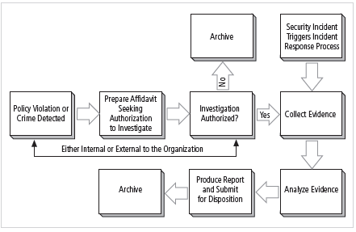
Figure 12-17 The Digital Forensics Process
Principles of Information Security, Fourth Edition

Slide 60
Evidentiary Procedures
Strong procedures for the handling of potential evidentiary material can minimize the probability of an organization’s losing a legal challenge
Organizations should develop specific procedures with guidance, for example:
  Who may conduct an investigation and who is authorized in an investigation
  What affidavit- and search warrant-related issues are required
  The methodology to be followed
  The final report format
Principles of Information Security, Fourth Edition

Slide 61
Summary
Maintenance of information security program is essential
Security management models assist in planning for ongoing operations
It is necessary to monitor external and internal environment
Planning and risk assessment are essential parts of information security maintenance
Principles of Information Security, Fourth Edition

Slide 62
Summary (cont’d.)
Need to understand how:
  Vulnerability assessment and remediation tie into information security maintenance
  To build readiness and review procedures into information security maintenance
  Digital forensics and management of digital forensics function
Principles of Information Security, Fourth Edition

